Slide 1
Chapter 14 Linear Algebra and Systems of Linear Equations
By
Hyung Jae (Chris) Chang
Troy University

Slide 2


Linear Transformations
F(ax + by) = aF(x) + bF(y) where x and y are vectors and a and b are scalars.
Multiplication of m x n matrix A and n x 1 vector v is linear transformation of v → a matrix will be synonymous with a linear transformation function.
If A is an m x n matrix, then there are two important subspaces associated with A: one is $ℝ^{n}$ and the other is $ℝ^{m}$ .
The domain of A is a subspace of $ℝ^{n}$; it is the set of all vectors that can be multiplied by A on the right.
The range of A is a subspace of $ℝ^{m}$; it is the set of all vectors y such that y = Ax.
It can be denoted as R(A) where R(A) = $\left\{y∈ℝ^{m}:Ax=y\right\}$
It is the set of all linear combinations of the columns in A where xi is the coefficient of the ith column in A.
Null space: $N\left(A\right)= \left\{x∈ℝ^{n}:Ax=0_{m}\right\}$ where $0_{m}$ is zero vector.

Slide 3
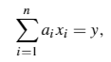
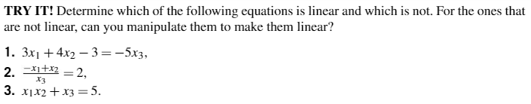
Systems of Linear Equations
Examples

Slide 4
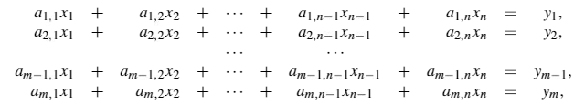
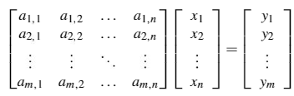

Systems of Linear Equations (cont.)
A set of linear equations sharing the same variables.
Matrix form of a system of linear equations is Ax = y.
where a_{i,j} and y_{i} are real numbers.
where A is an m x n matrix, A(i, j) = a_{i,j}, y is a vector in $ℝ^{m}$, and x is an unknown vector in $ℝ^{n}$.

Slide 5
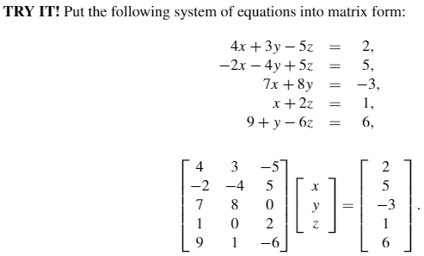
Systems of Linear Equations (cont.)
Example

Slide 6
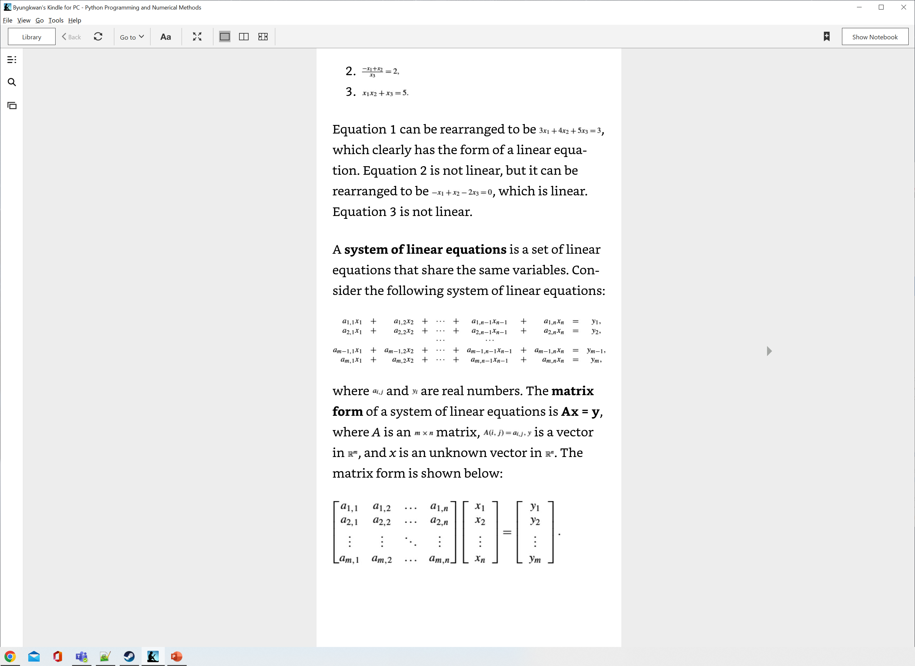

Solutions to Systems of Linear Equations
m equations and n unknows
Solution is x in $ℝ^{n}$ that satisfies the matrix form equation
Three distinct solution possibilities for x depending on the values of A and y.

Slide 7

Solutions to Systems of Linear Equations (cont.)
Three possible solutions for x
Case 1: No solution
If rank ([A, y]) = rank(A) + 1, then y is linearly independent from the columns of A.
Since y is not in the range of A, by definition there can’t be an x that satisfies the equation.
Case 2: One unique solution
If rank([A, y]) = rank(A), then y can be written as a linear combination of the columns of A, and there is at least one solution from the matrix equation.
rank(A) = n must be true; meaning that the number of equations must be exactly equal to the number of unknowns.
$m<n, rank\left(\left[A,y\right]\right)=n$ → cannot be true
$m=n, rank\left(\left[A,y\right]\right)=n$ → A is square and invertible (unique), $Ax=y$solved by${ A}^{−1}Ax=A^{−1}y →x=A^{−1}y$
$m>n, rank\left(\left[A,y\right]\right)=n$ → more equations than unknowns. Since $rank\left(\left[A,y\right]\right)=n,$ possible to choose n equations

Slide 8
Solutions to Systems of Linear Equations (cont.)
Three possible solutions for x
Case 3: Infinitely many solutions
If rank([A, y]) = rank(A), then y is in the range of A, and there is at least one solution for the matrix equation; however, if rank(A)<n, then there are infinitely many solutions.

Slide 9
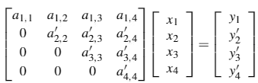
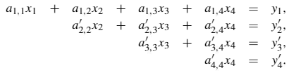
Gauss Elimination Method
A procedure that turns the matrix A into an upper-triangular form to solve the system of equations.
Example: four equations and four variables
x₄ can be easily solved; simple division y’₄/a’_{4,4}.
x₃ is solved by substituting x₄.
Keep going in backward to solve for all x → called backward substitution.
If A were a lower-triangular matrix, we would solve the system top-down by forward substitution.

Slide 10
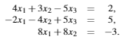
Gauss Elimination Method (cont.)
Use Gauss elimination, solve the following equations:

Slide 11
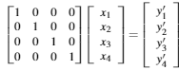
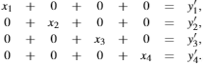
Gauss-Jordan Elimination Method
A procedure to turn A into a diagonal form such that the matrix form of the equations becomes

Slide 12
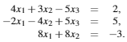
Gauss-Jordan Elimination Method (cont.)
Use Gauss-Jordan elimination to solve the following equations.

Slide 13
LU Decomposition Method
Sometimes, we may have the same set of equations but different sets of y for different experiments. (where y_{a}, y_{b}, y_{c}… are different experiment observations)
Therefore, we must solve Ax=y_{a}, Ax=y_{b}, … → any computations: inefficient method
LU decomposition method changes the matrix A only into the product of two matrices L (lower triangular matrix) and U (upper triangular matrix).

Slide 14
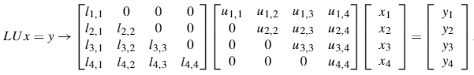
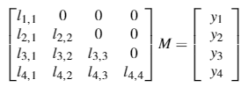
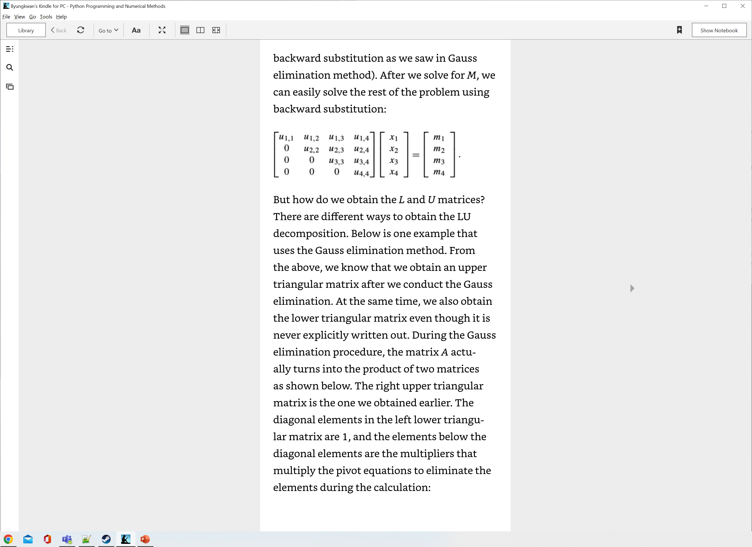
LU Decomposition Method (cont.)
The system of equations are converted to the following form:
If Ux = M, then the above equations become:
where M =

Slide 15
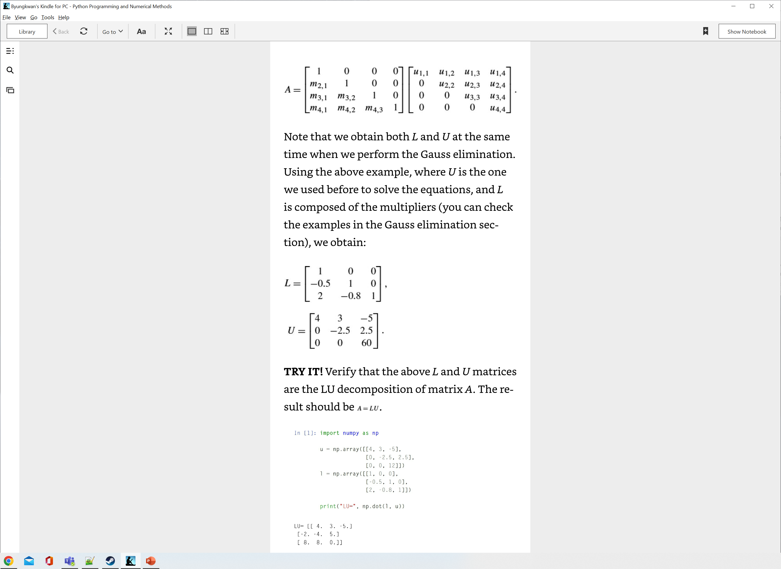
LU Decomposition Method (cont.)
Then how do we obtain L and U matrices?
One way is to use the Gauss elimination method.
What are L and U for the previous example?

Slide 16
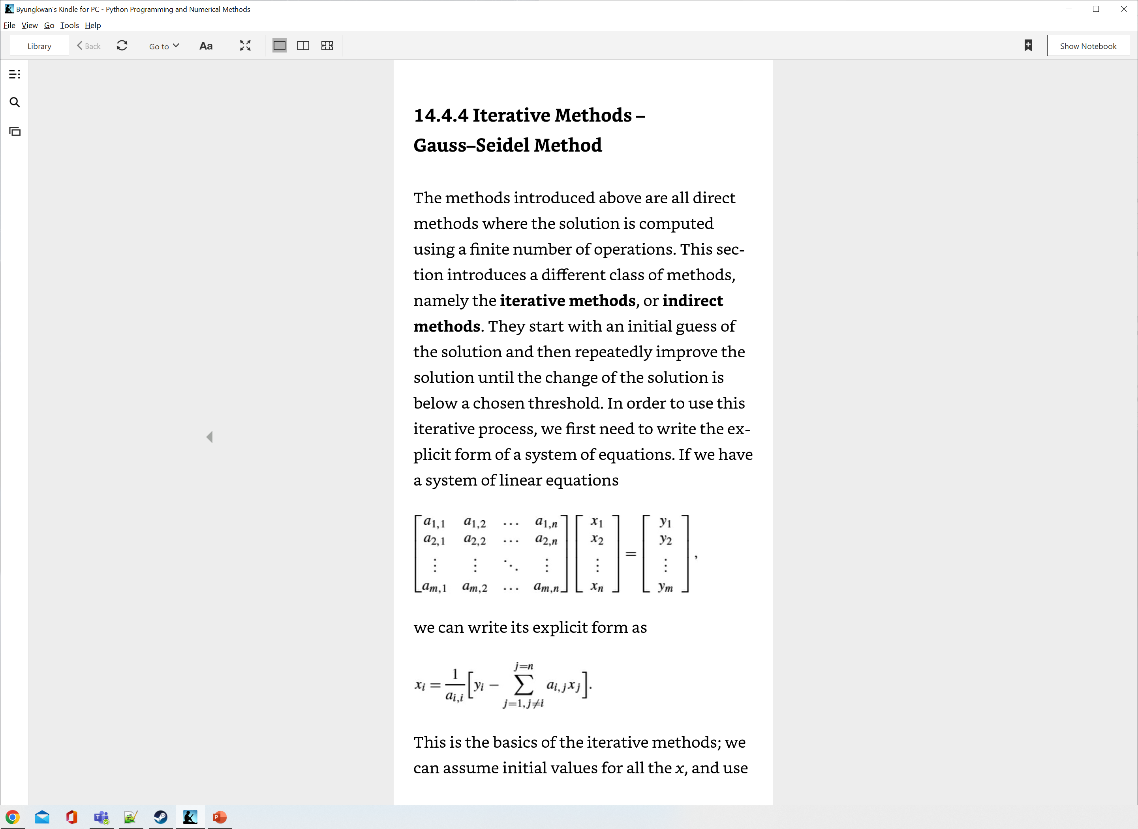
Iterative Methods
Indirect method: start by initial guess of the solution and repeat to improve the solution until the change of the solution is below a chosen threshold.
Specific conditions for the solution to converge
The coefficient matrix A is diagonally dominant meaning that in each row of the matrix of coefficients a, the absolute value of the diagonal element is greater than the sum of the absolute values of the off-diagonal elements → this condition is sufficient but not necessary. (trị tuyệt đối của phần tử đường chéo lớn hơn tổng trị tuyệt đối các phần tử còn lại trên hàng)

Slide 17
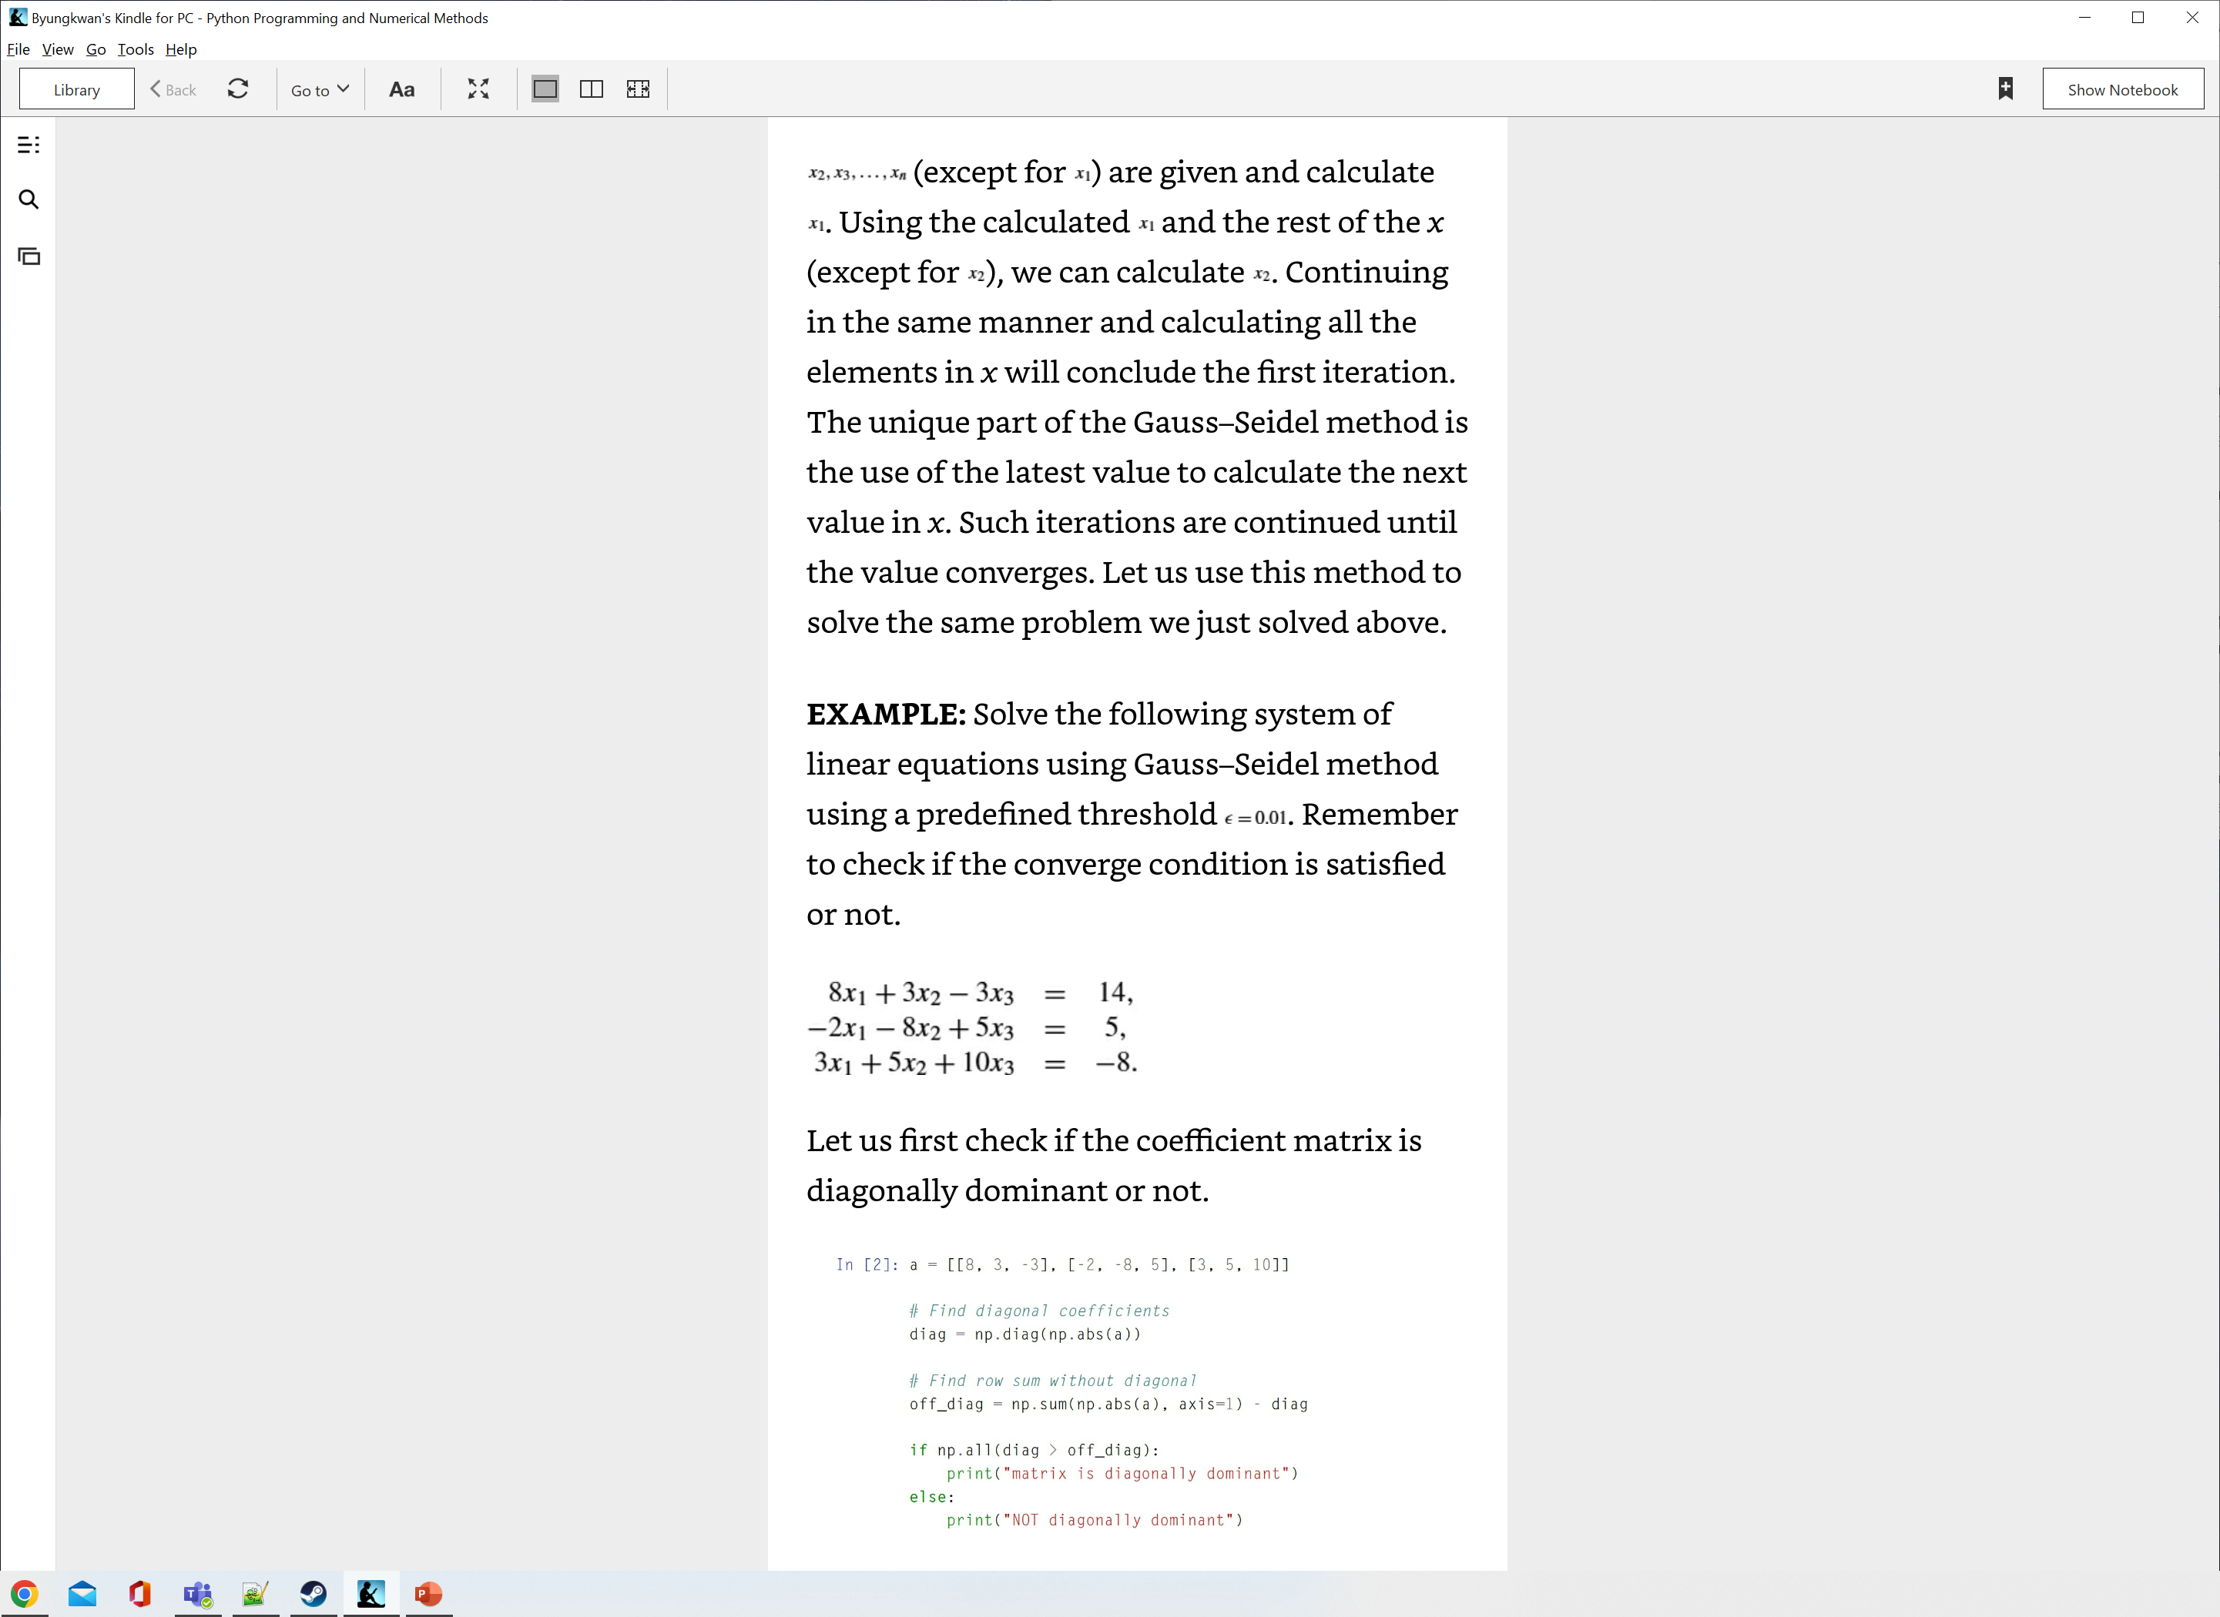
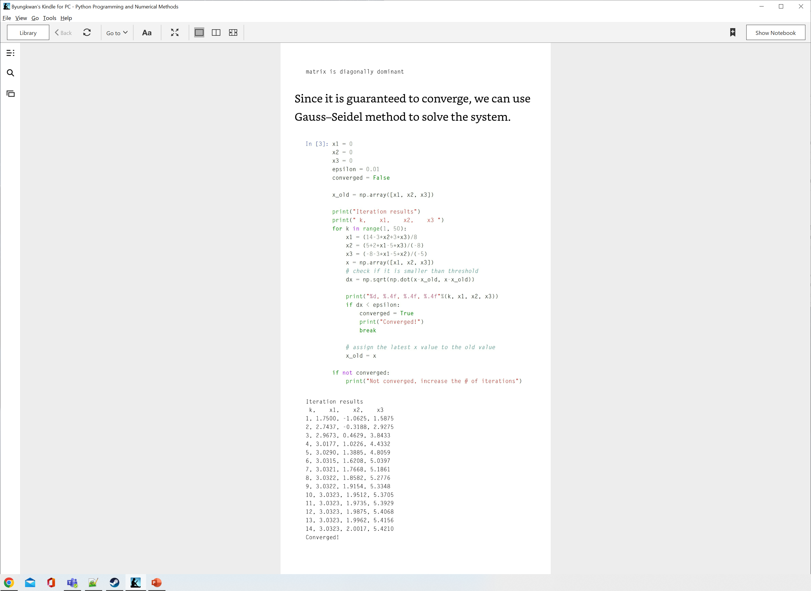
Gauss-Seidel Method
Specific iterative method that always uses the latest estimated value for each element in x.

Slide 18
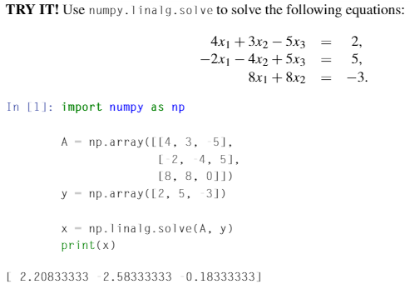
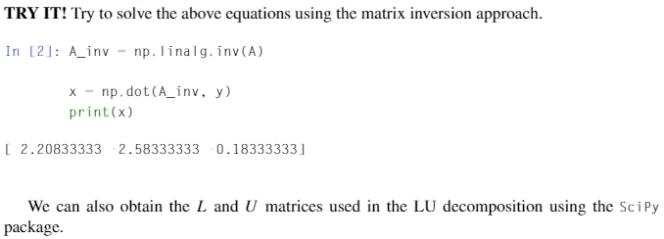
Solving Systems of Linear Equations in Python

Slide 19
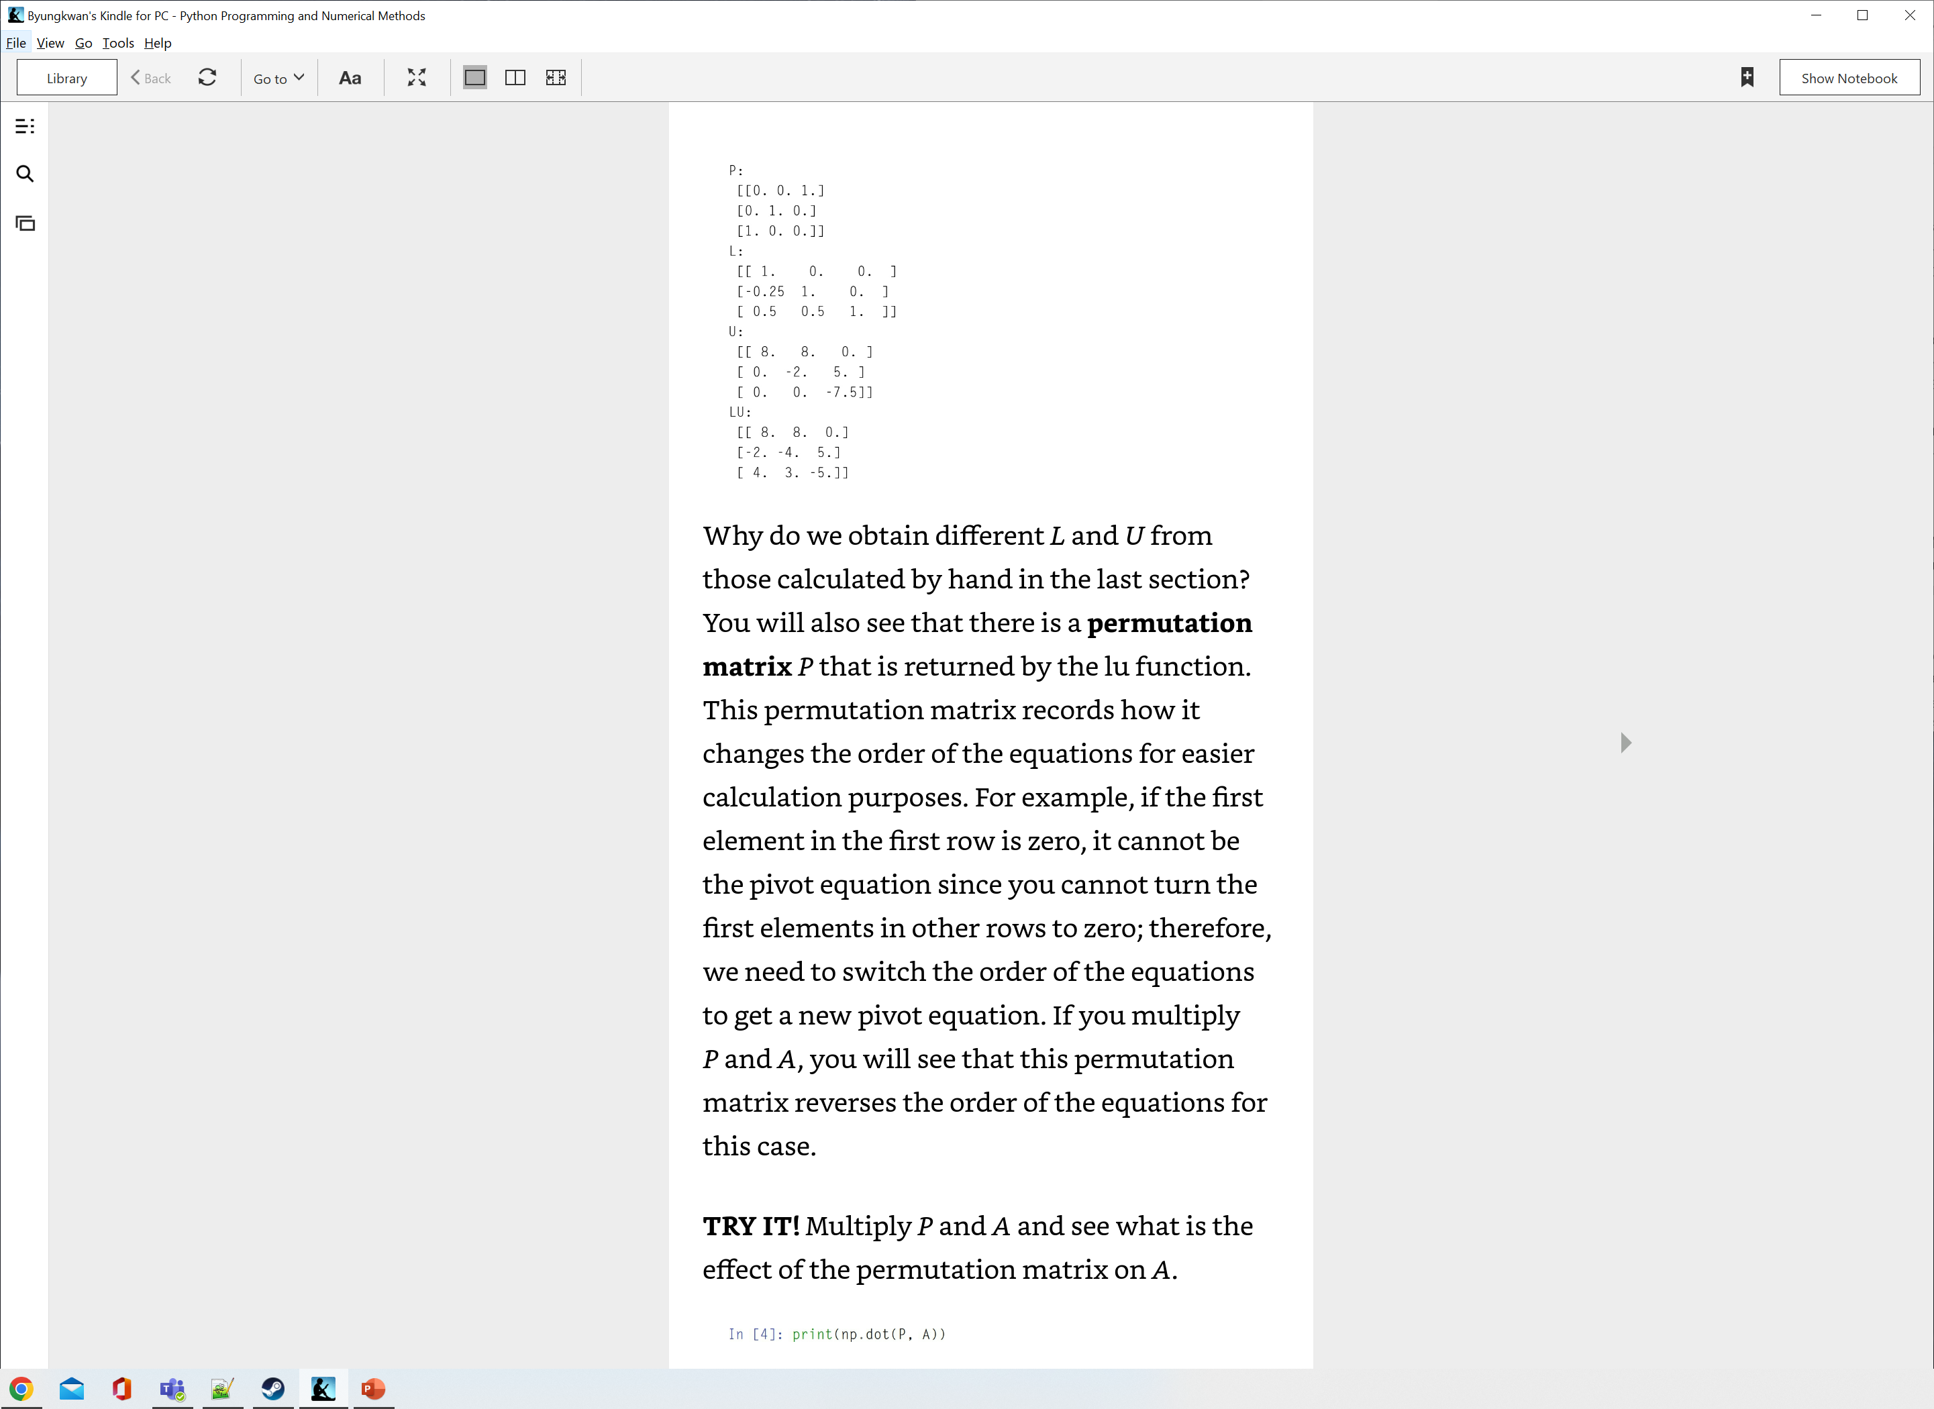
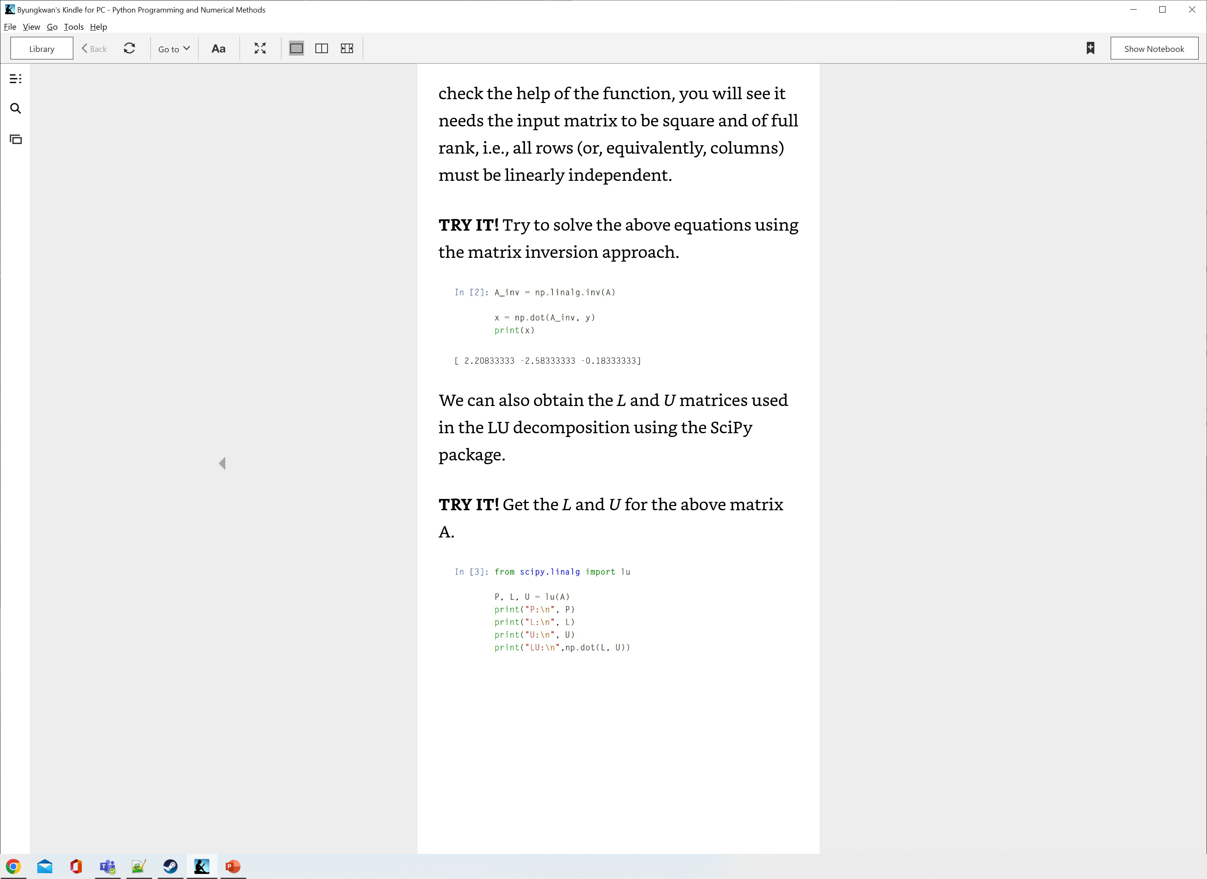
Solving Systems of Linear Equations in Python (cont.)

Slide 20
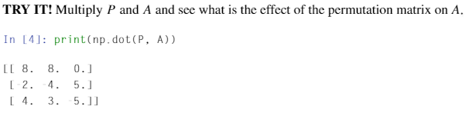
Solving Systems of Linear Equations in Python (cont.)
Permutation matrix P from L and U from the previous calculation.
Records how it changes the order of the equations for easier calculation purposes.
Example
When the first element in the first row is zero, it can’t be the pivot equation since we can’t use it to make the first elements in other rows to zero.
We have to switch the order of the equations to get a new pivot equation.

Slide 21
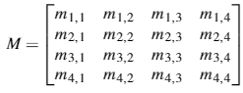
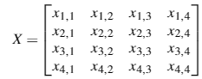
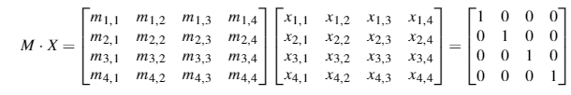
Matrix Inversion
Inverse of a square matrix M: a matrix of the same size M⁻¹ such that M ∙ M⁻¹ = M⁻¹∙M = 1.
X is an inverse of M
?
As the dimension of the matrix gets higher,
the analytic solution for the matrix inversion will become complex.

Slide 22
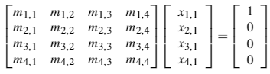
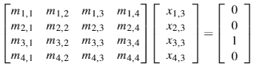
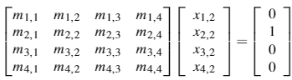
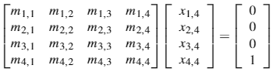
Matrix Inversion (cont.)
We can rewrite the equation in the previous slide as four separate equations.
By using one of the methods introduced previously (such as Gauss elimination, Gauss-Jordan, and LU decomposition), we can obtain the inverse of the matrix.

